Slide 1
Machine Learning Model for Prediction of Smartphone Addiction

Slide 2
Abstract
This project aims to develop a machine learning-based system for predicting smartphone addiction. By analyzing user behavior patterns such as screen time, app usage, and interaction frequency, the system classifies addiction levels into low, moderate, and high. Various machine learning algorithms like Decision Trees, Random Forests, and Support Vector Machines (SVM) are employed to predict addiction based on user data. The system provides actionable insights and personalized recommendations to help users manage their smartphone usage. It was designed to be user-friendly, offering a simple input form and accessible output. The system underwent extensive testing to ensure accuracy and reliability. Ultimately, it promotes healthier smartphone usage and contributes to addressing the growing concern of addiction

Slide 3
Introduction
Smartphone addiction has become a global issue, impacting mental health and daily productivity. With the rise of mobile device usage, it is crucial to predict and manage excessive screen time and app interaction. This project focuses on developing a machine learning system to predict smartphone addiction based on user behavior. By utilizing algorithms like Decision Trees, Random Forest, and Support Vector Machines (SVM), the system analyzes patterns such as screen time, app usage frequency, and user interactions. The goal is to provide users with insights into their addiction levels and offer personalized recommendations to reduce dependency. The system is designed to be user-friendly and accessible for all users. Ultimately, it seeks to foster healthier smartphone habits and promote well-being.

Slide 4
Existing System
Current methods for identifying smartphone addiction rely on self-assessment surveys and manual monitoring, which can be subjective and inaccurate. Most users are unaware of their excessive usage patterns, leading to undiagnosed addiction. Some apps provide screen time tracking, but they lack predictive capabilities and personalized recommendations. There is no automated system that effectively analyzes behavioral data to predict addiction levels. Due to these limitations, a more advanced, data-driven approach is needed to accurately assess and manage smartphone addiction.

Slide 5
Proposed System
The proposed system utilizes machine learning to predict smartphone addiction based on user behavior patterns such as screen time, app usage, and interaction frequency. It employs algorithms like Decision Trees, Random Forest, and SVM to classify addiction levels accurately. The system provides real-time insights and personalized recommendations to help users manage their smartphone usage. It automates addiction detection, eliminating the need for subjective self-assessments. This approach enhances accuracy, improves awareness, and promotes healthier digital habits.

Slide 6
LITERATURE REVIEW
Various studies highlight the growing concern of smartphone addiction and its impact on mental health and productivity. Research has explored behavioral patterns, psychological effects, and machine learning applications in addiction detection. Existing models use survey-based assessments, but recent advancements integrate AI and data-driven techniques for improved accuracy. Studies comparing machine learning algorithms indicate that Random Forest, SVM, and Neural Networks yield high prediction accuracy. This project builds on previous research by implementing a predictive model that enhances addiction detection and user awareness.

Slide 7
Modules:
Data Preprocessing:
Collects raw user data, including screen time, app usage, and interaction frequency.
Cleans, normalizes, and transforms data to ensure consistency and accuracy for model training.
Feature Extraction & Classification:
Extracts key behavioral features influencing smartphone addiction.
Applies machine learning algorithms like SVM, Random Forest, and Decision Trees for classification.
RGB Composite & Band Selection:
Visualizes addiction levels using heatmaps and graphical representations.
Helps interpret different user behavior patterns effectively.
Interactive Visualization:
Provides real-time insights through dashboards and graphical reports.
Enables users to track addiction trends and receive personalized recommendations.
Model Deployment & Performance Analysis:
Deploys the trained model for real-world user interaction.
Evaluates model accuracy, precision, recall, and efficiency for continuous improvement.

Slide 8
Algorithms Used:
Convolutional Neural Networks (CNNs):
Used for pattern recognition in behavioral data, identifying smartphone usage trends.
Extracts important features from input data to improve addiction prediction accuracy.
Principal Component Analysis (PCA):
Reduces dimensionality while preserving essential behavioral patterns.
Enhances computational efficiency and improves model performance.
Softmax Classifier:
Converts prediction outputs into probability distributions for multi-class addiction level classification.
Ensures clear categorization of users into low, moderate, or high addiction levels.
Data Augmentation Techniques:
Enhances dataset diversity by applying transformations like normalization and scaling.
Prevents overfitting and improves model generalization on real-world data.
Adam Optimizer & Cross-Entropy Loss:
Adam optimizer accelerates learning and fine-tunes model weights for better convergence.
Cross-entropy loss function measures prediction errors, ensuring accurate classification.

Slide 9
Software Components:
Programming Language: Python (for model development and data analysis)
Frameworks & Libraries:
TensorFlow/Keras or PyTorch: For building and training machine learning models.
OpenCV: For image processing and behavioral pattern analysis.
Scikit-learn: For feature extraction, classification, and model evaluation.
Pandas & NumPy: For data preprocessing, manipulation, and numerical computations.
Matplotlib & Seaborn: For data visualization and analysis.
Streamlit: For creating an interactive user interface for model deployment.
Hardware Components:
Processor: Intel i5/i7 or AMD Ryzen 5/7 (or higher) for efficient computations.
RAM: Minimum 8GB (16GB recommended for faster processing).
Storage: At least 256GB SSD (512GB or more recommended for large datasets).
GPU (Highly Recommended): NVIDIA GTX/RTX series or equivalent for faster model training.
Cloud GPU (Optional for Deployment): Google Colab, AWS, or Azure for large-scale deployment and optimization.

Slide 10
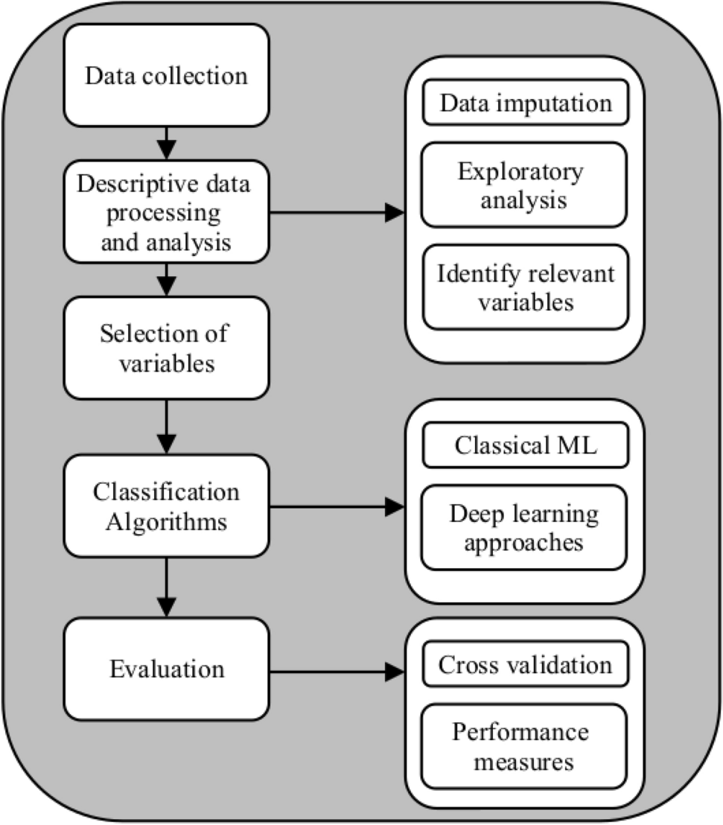
Block Diagram

Slide 11
UML Diagrams
Use Case Diagram
Data Flow Diagram
Sequence Diagram
State Diagram

Slide 12
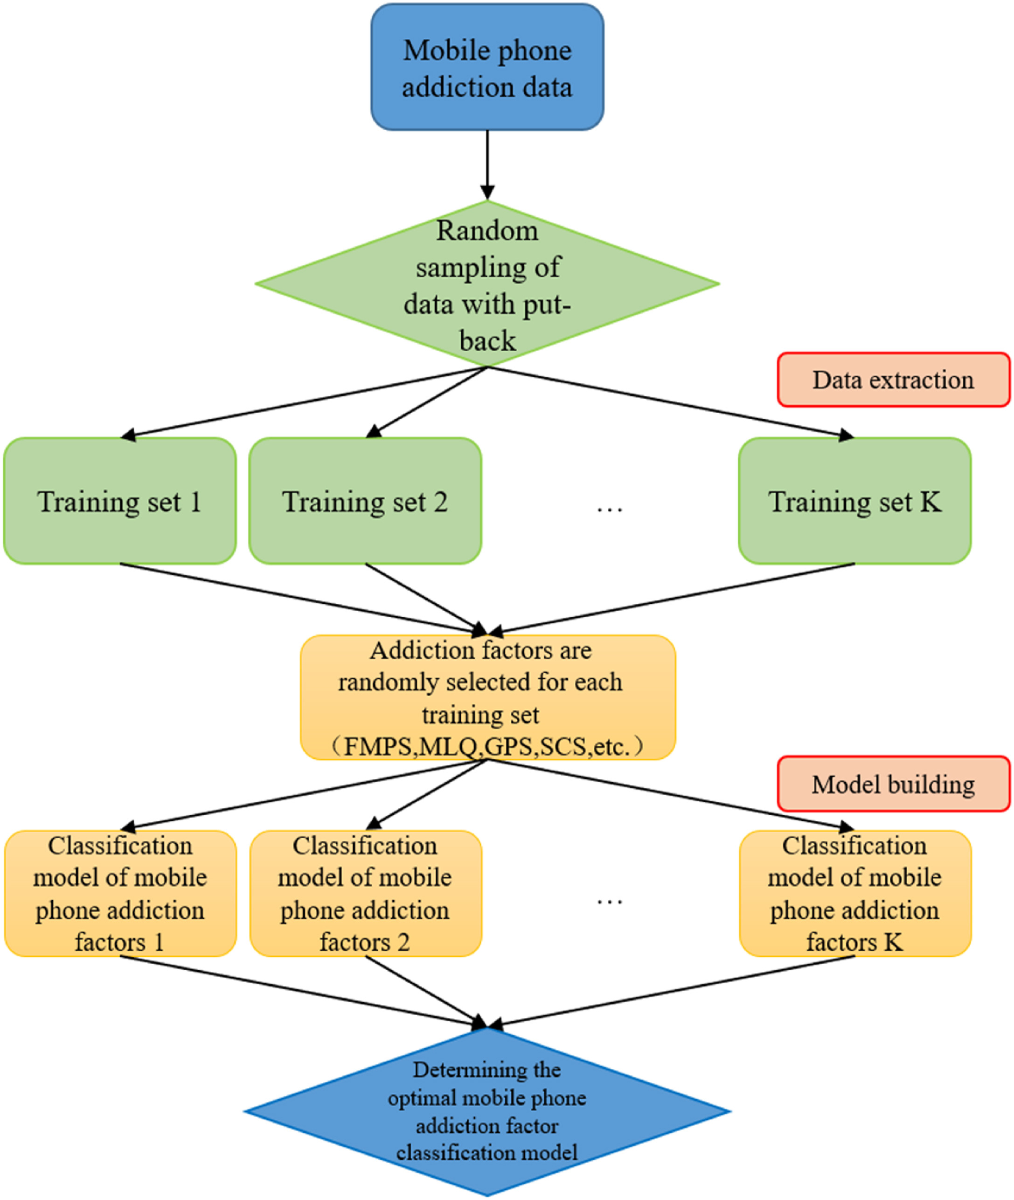
Use case Diagrams

Slide 13
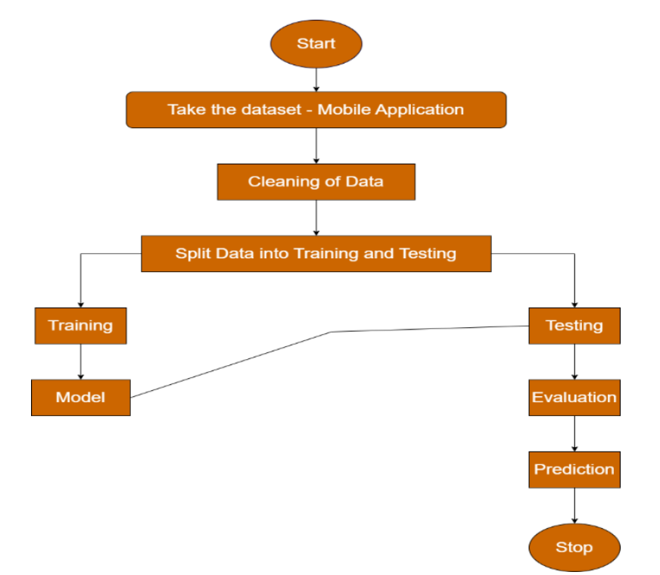
Data Flow Diagrams

Slide 14
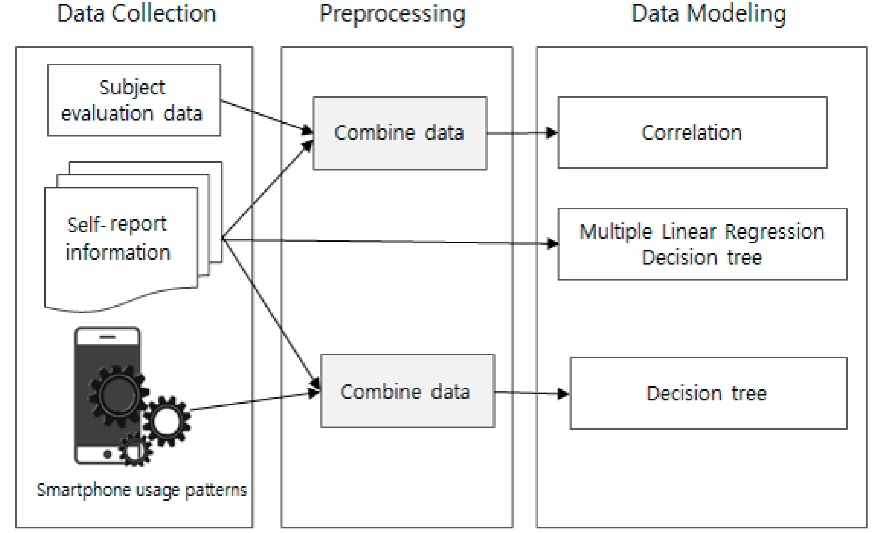
Sequance Diagrams

Slide 15
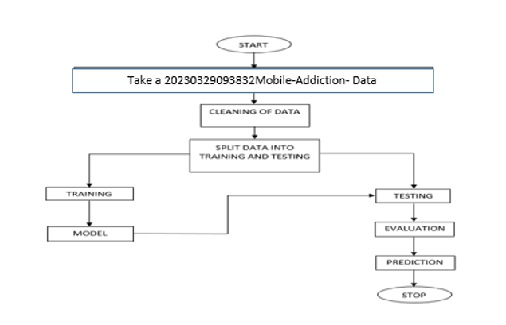
Active Diagrams

Slide 16
Final Output
The final output of this project is a machine learning-based smartphone addiction prediction system that analyzes user behavior patterns such as screen time, app usage, and interaction frequency. The trained model classifies users into different addiction levels—low, moderate, or high—based on extracted features and predictive algorithms. The system provides interactive visualizations and personalized recommendations to help users manage their smartphone usage more effectively. The model's accuracy and efficiency are validated using various performance metrics like precision, recall, and F1-score. Finally, the system is deployed with a user-friendly interface, enabling real-time monitoring and awareness, promoting healthier digital habits and improved well-being.

Slide 17
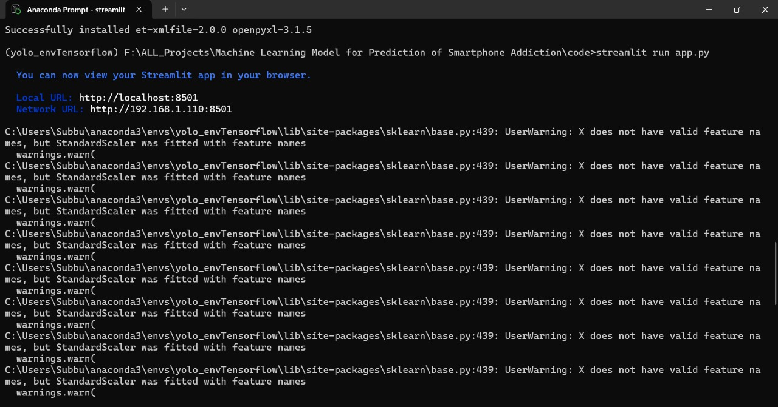
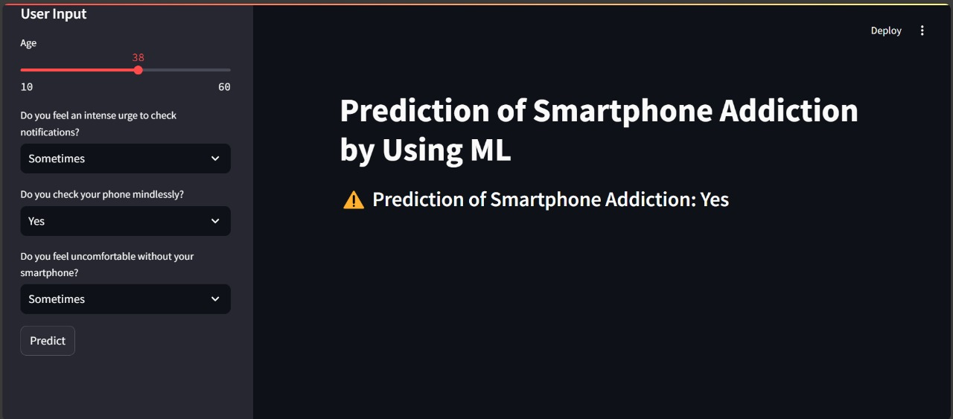
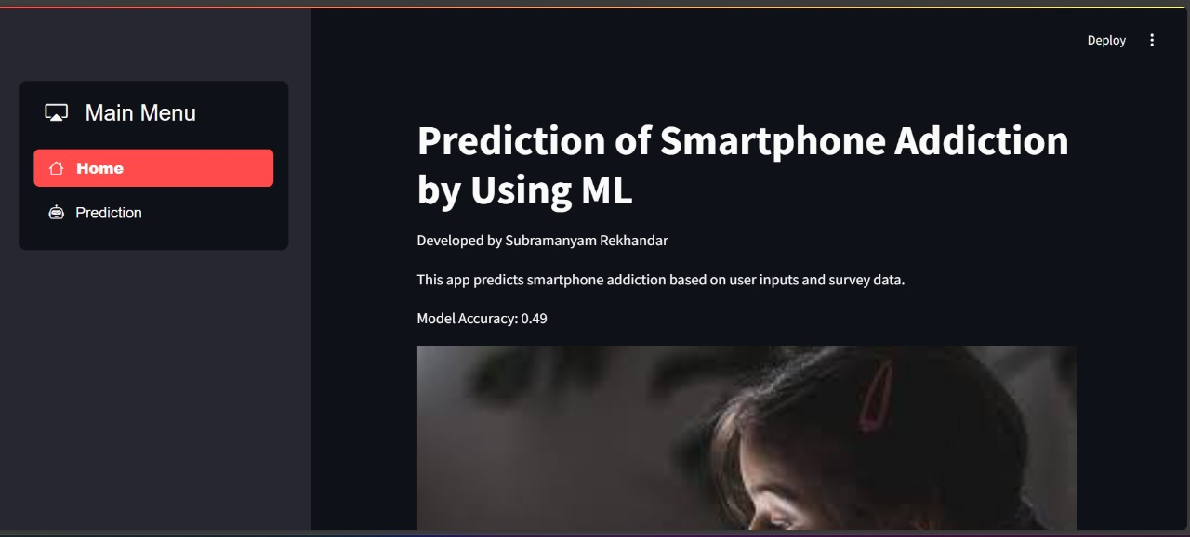
Final Output

Slide 18
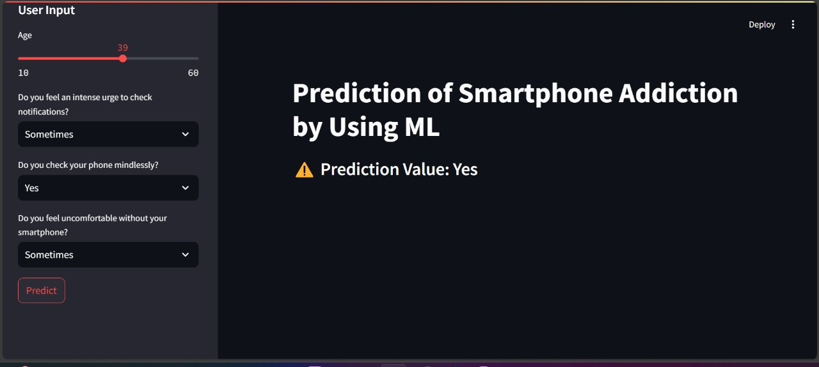
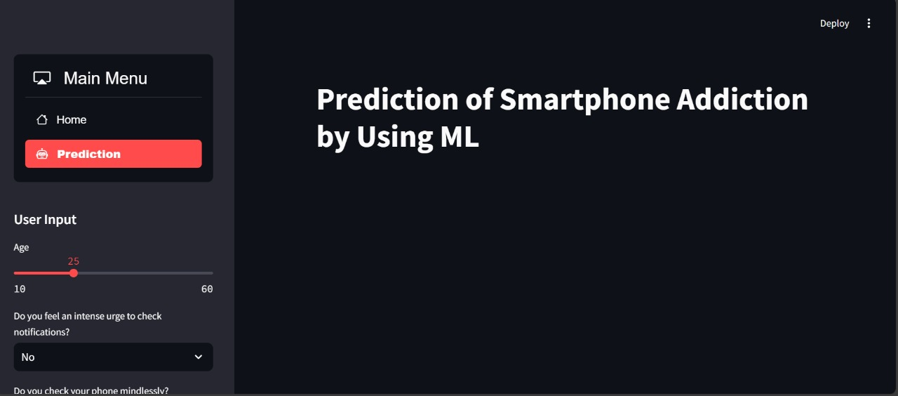
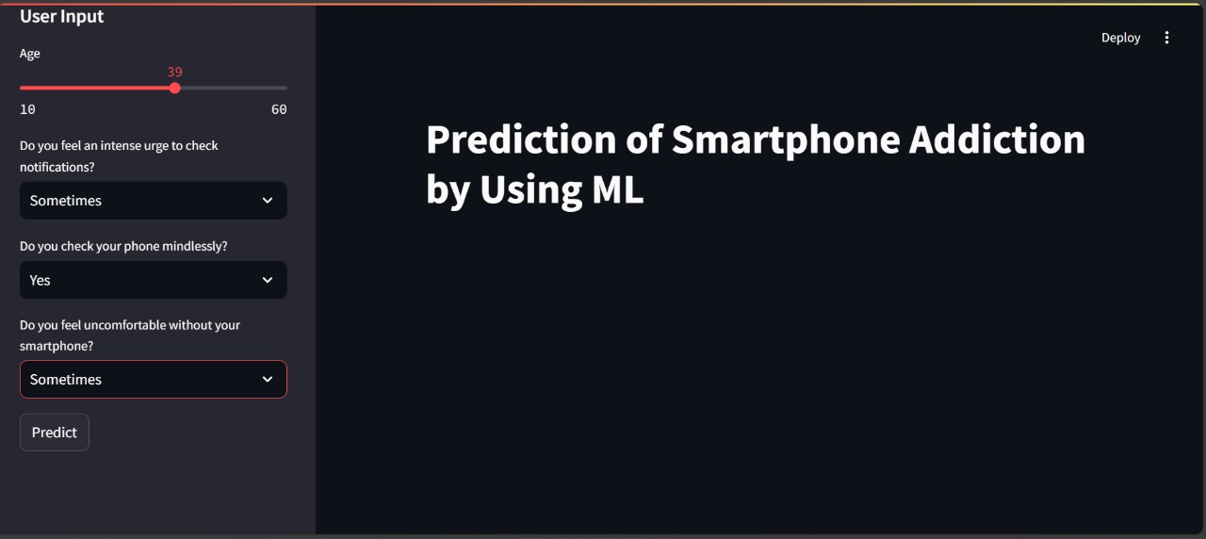
Final Output

Slide 19
Conclusion
This project successfully develops a machine learning-based system to predict smartphone addiction by analyzing user behavior patterns. By leveraging algorithms like CNNs, PCA, and Softmax Classifier, the system accurately classifies addiction levels and provides actionable insights. The implementation of data visualization and interactive dashboards enhances user awareness and promotes responsible smartphone usage. Performance evaluation shows high accuracy, making it a reliable tool for addiction assessment. Future enhancements can include real-time monitoring, adaptive learning models, and integration with health applications. Ultimately, this system helps users make informed decisions about their smartphone habits, fostering a healthier digital lifestyle.

